Slide 1

Toolkit Doc17 Head
May 6, 2010

Slide 2
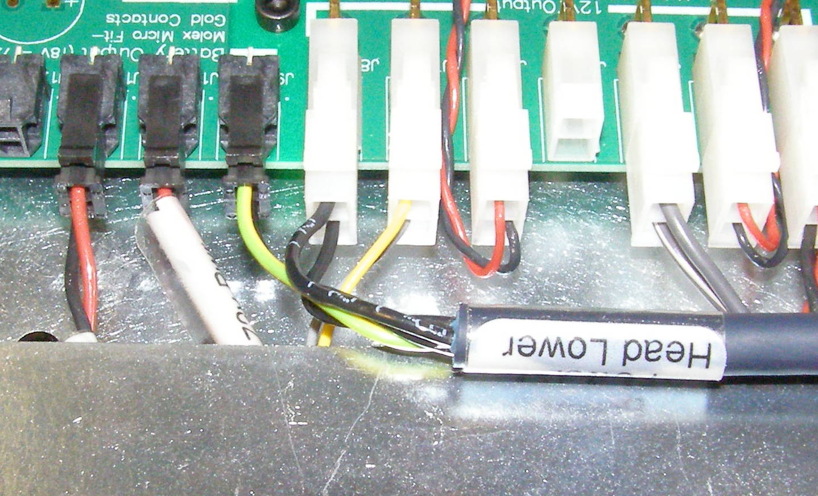
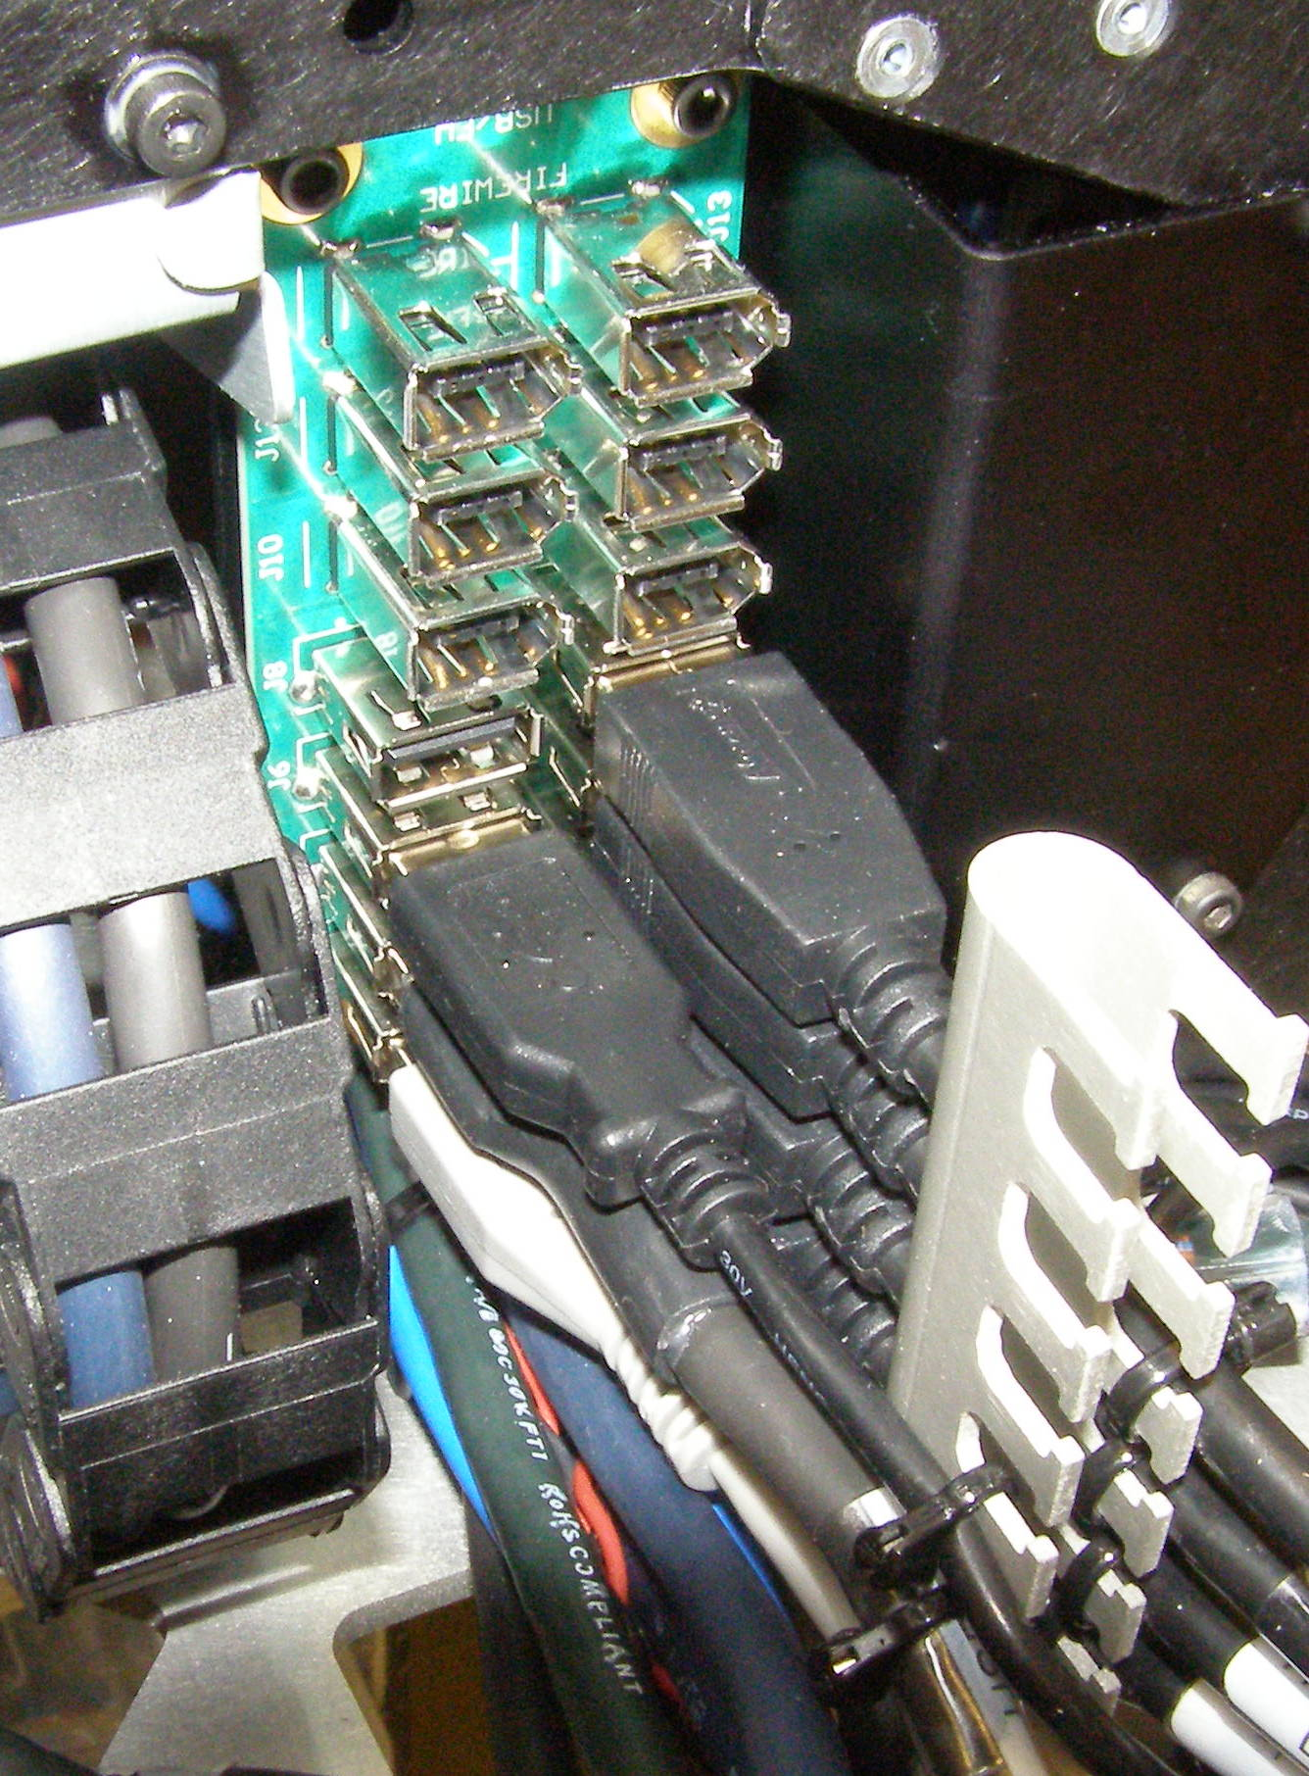
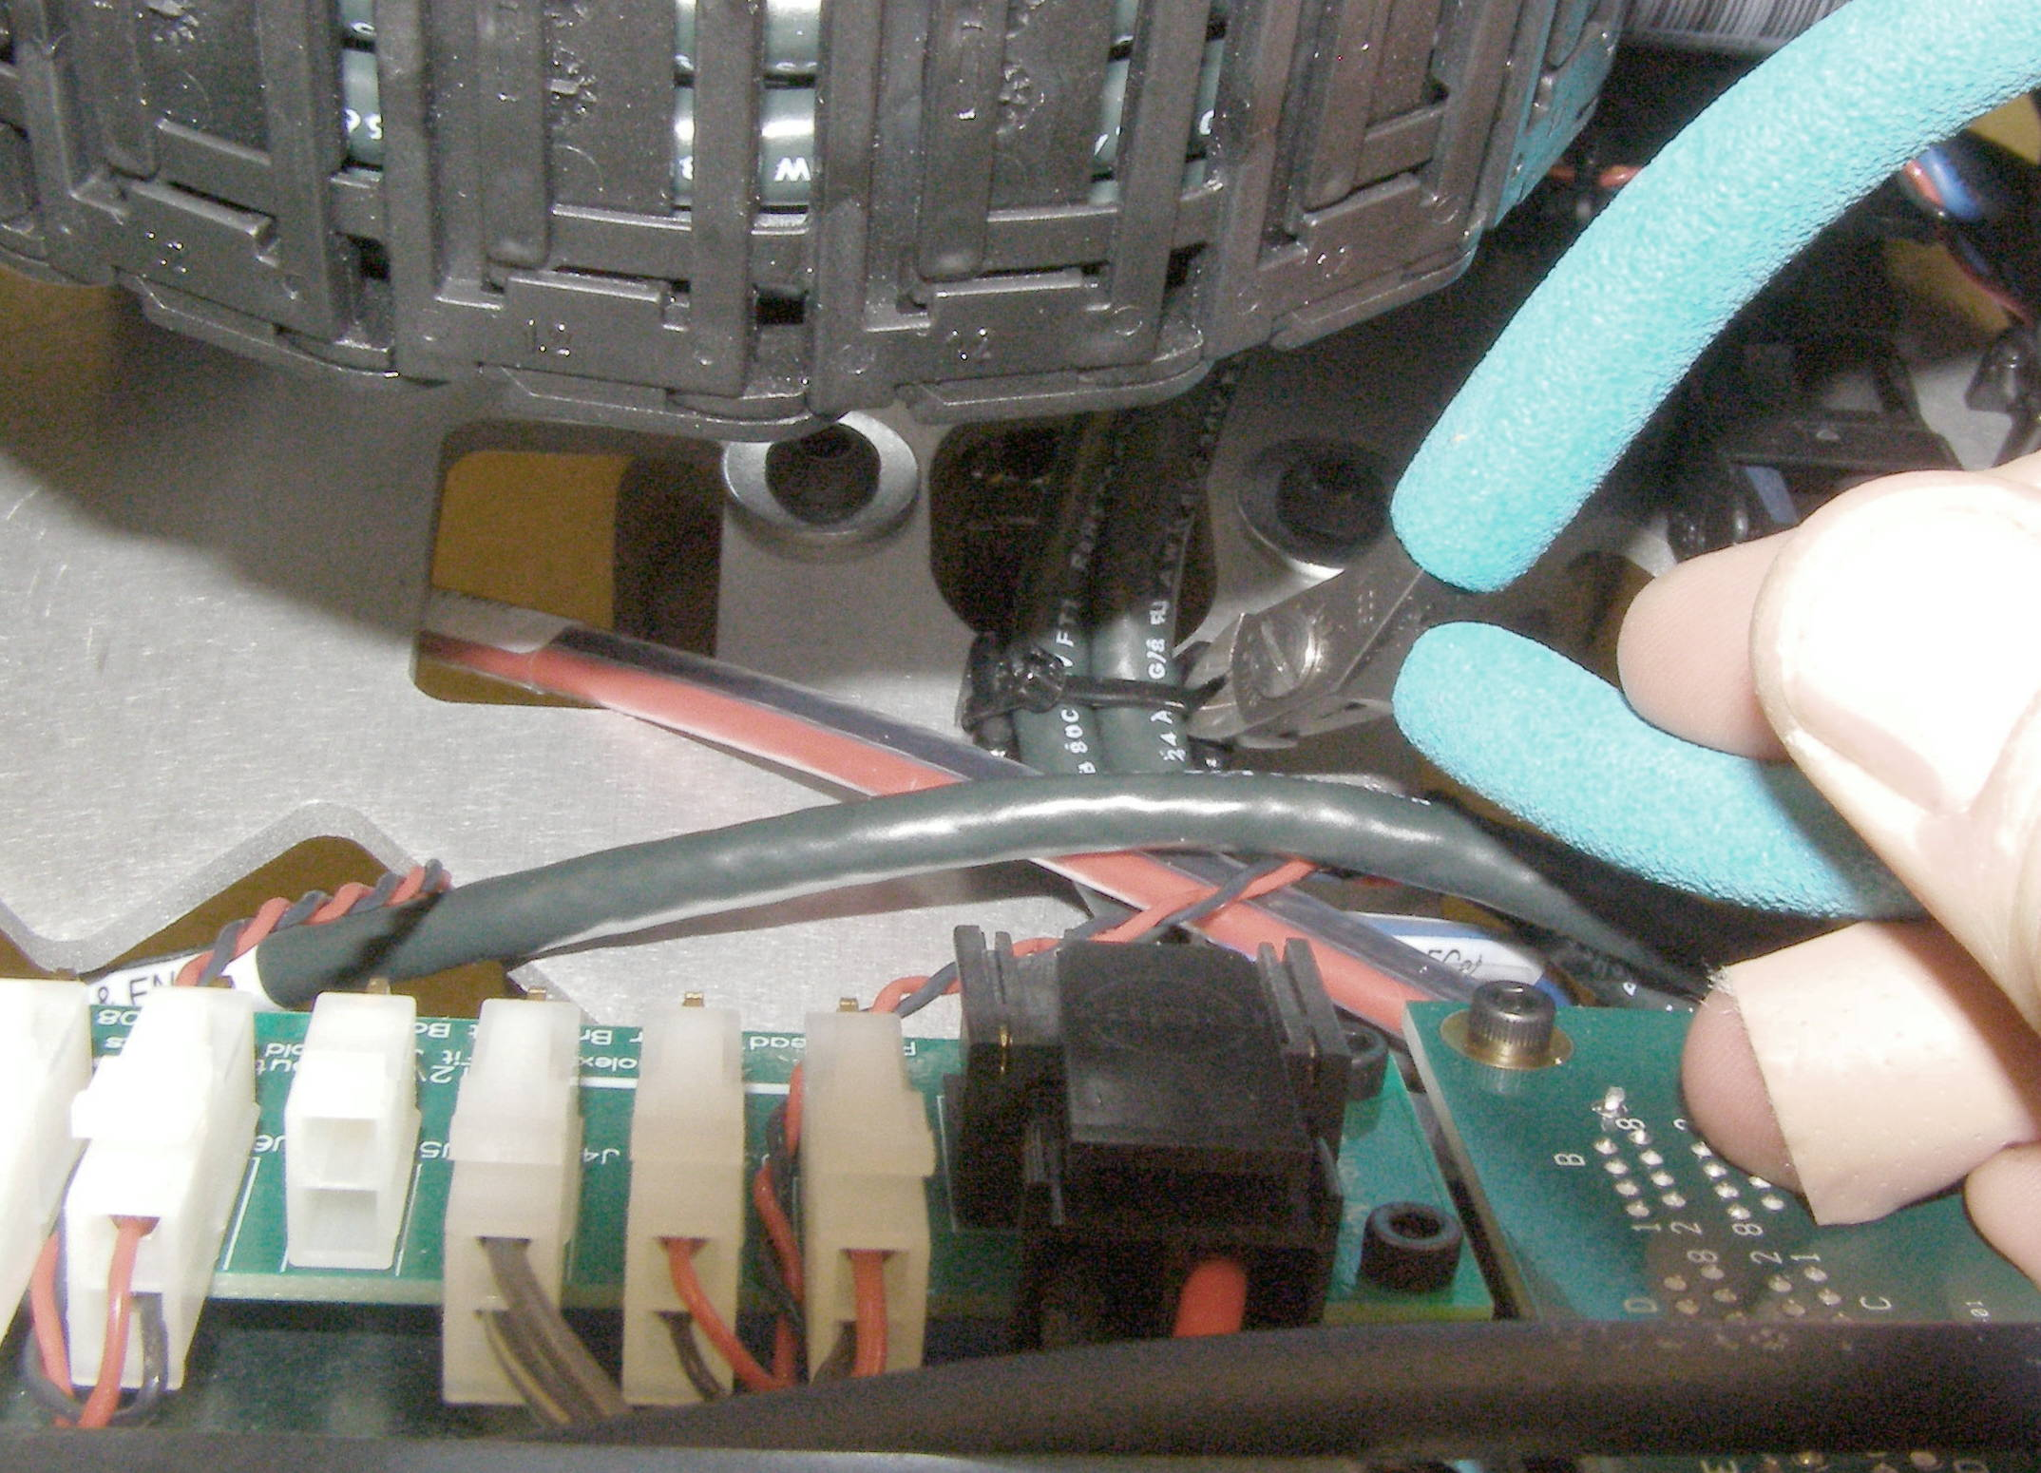
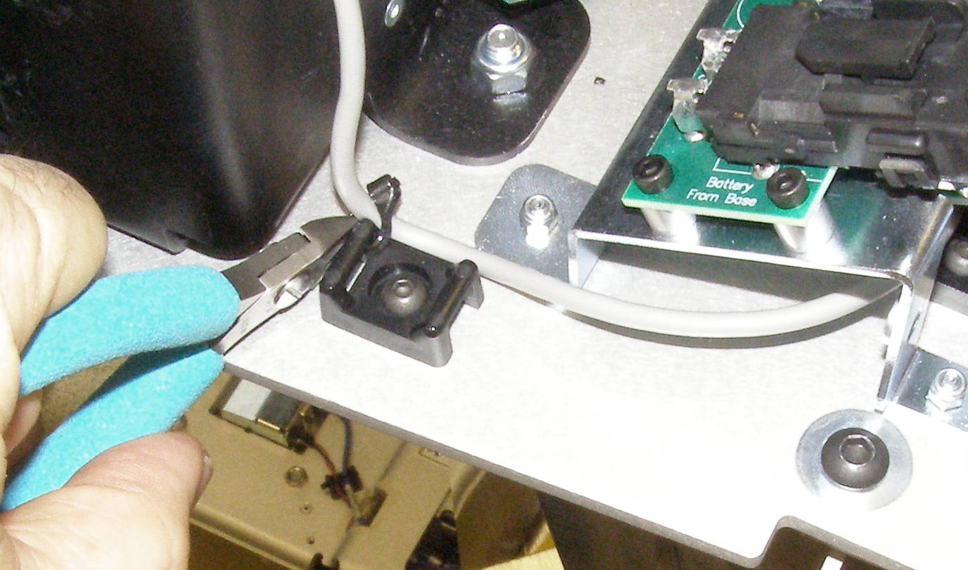
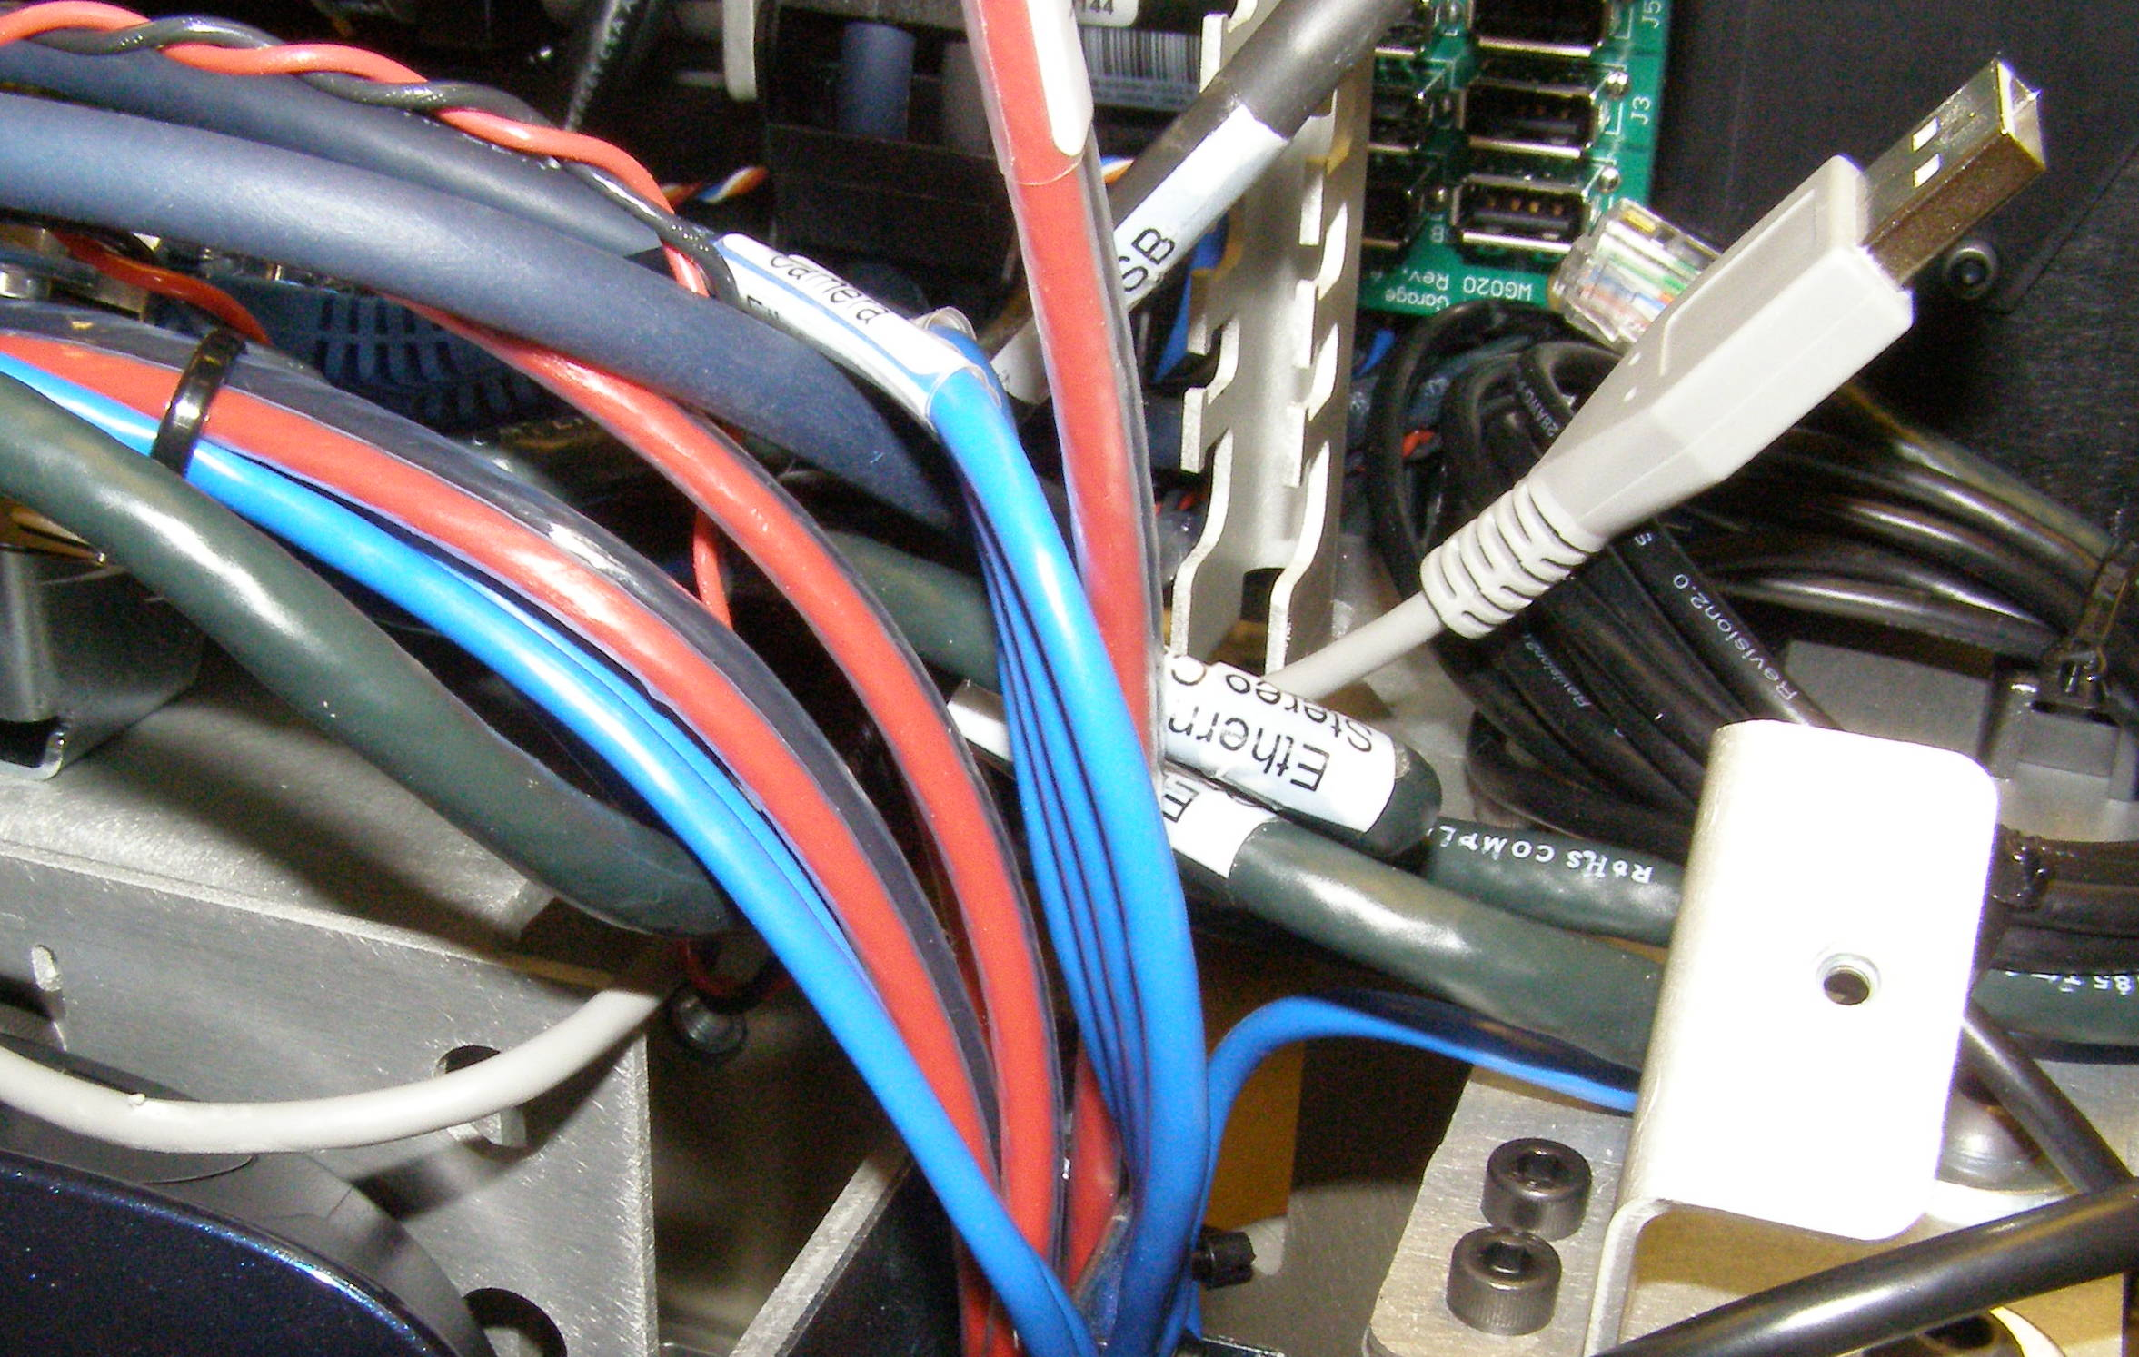
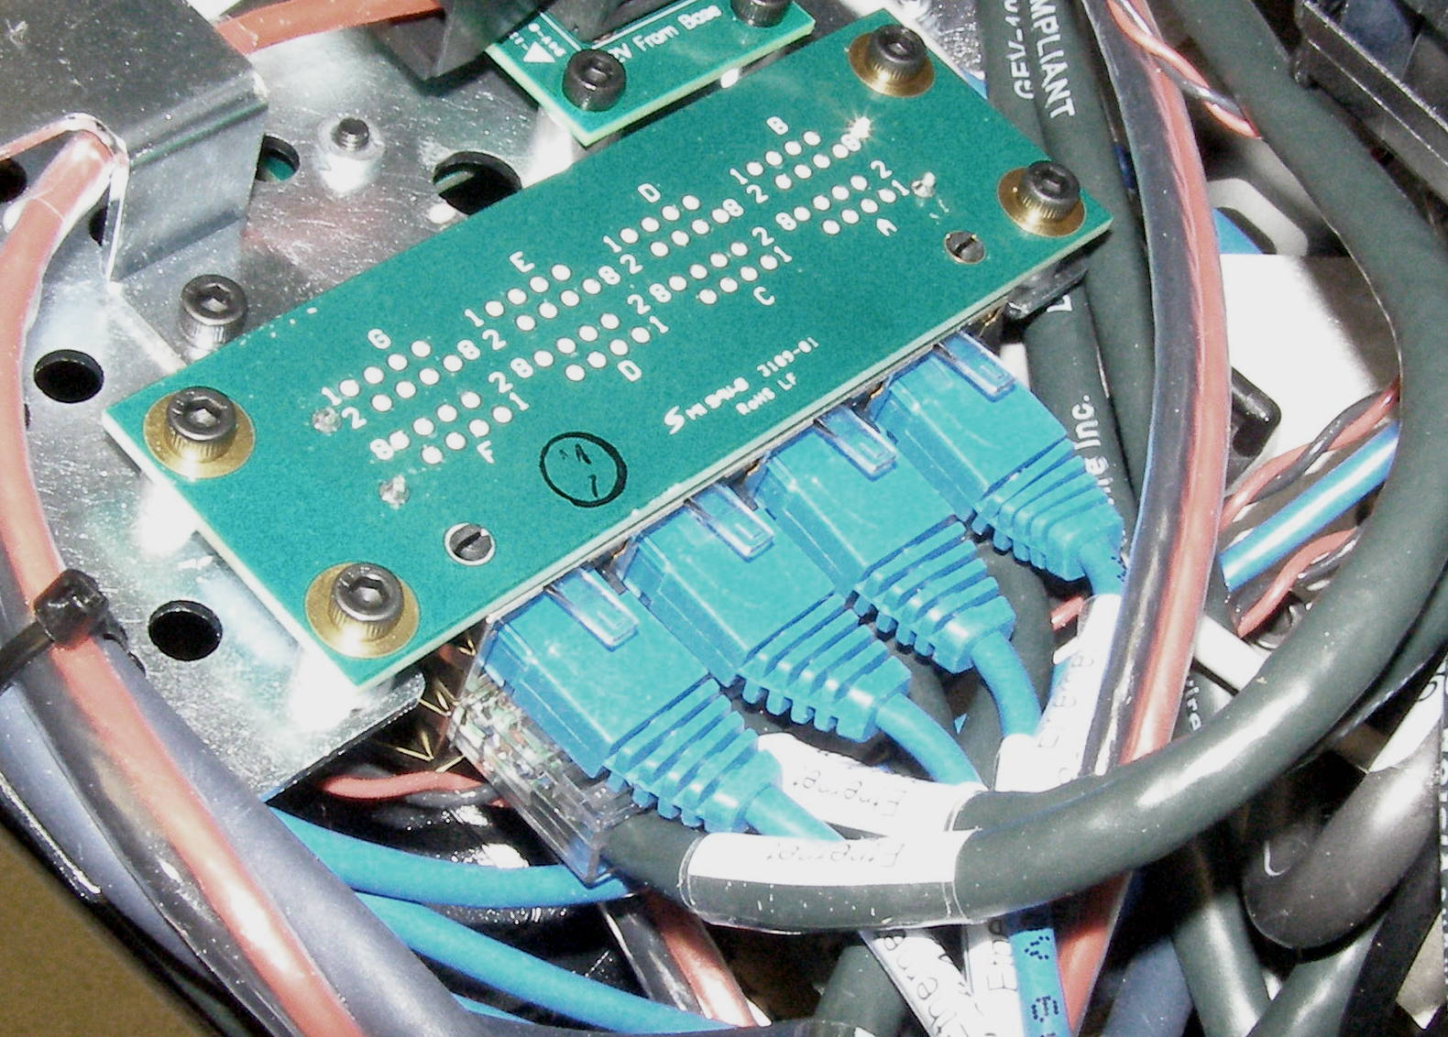
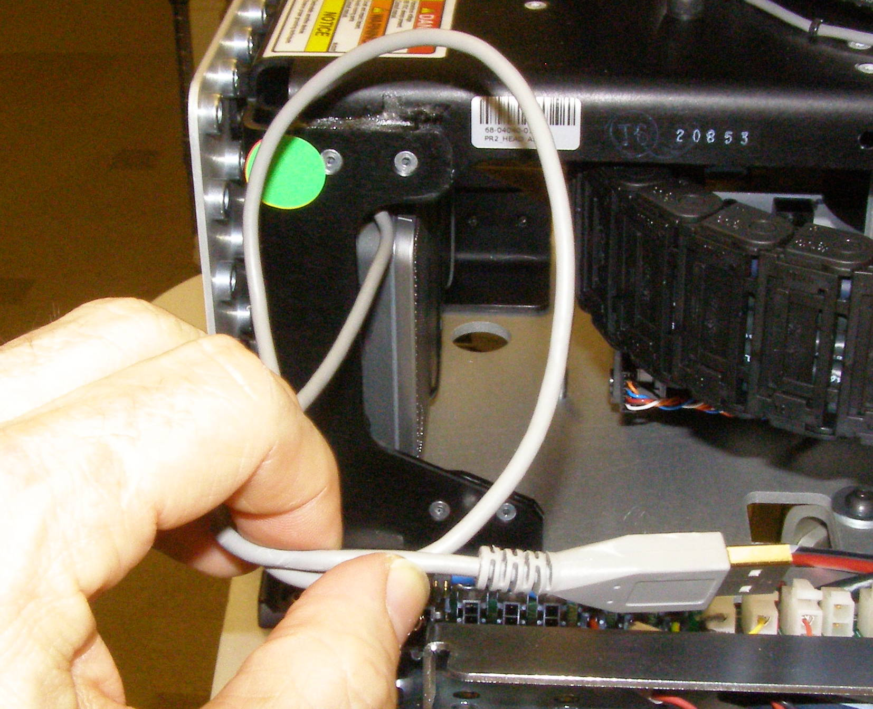
Head Removal (1)
Head, Removal - 4040
  Remove Front and Rear Top Covers.
  Cut the zip-ties and unplug 7 USB cables
  (Fig 1)
  Cut the zip-ties for the Gray Speaker USB cable and pull it from underneath the wire bundles. (Fig 2,3,4)
  Unplug the “72+12v Power Head Lower” cable, 2 connectors. (Fig 5)
  Cut the zip-tie under the Head energy chain. (Fig 6)
  Unplug all 8 cables from the Ethernet Hub. (Fig 7)
Fig 1
Fig 5
Fig 6
Fig 2
Fig 3
Fig 7
Fig 4

Slide 3
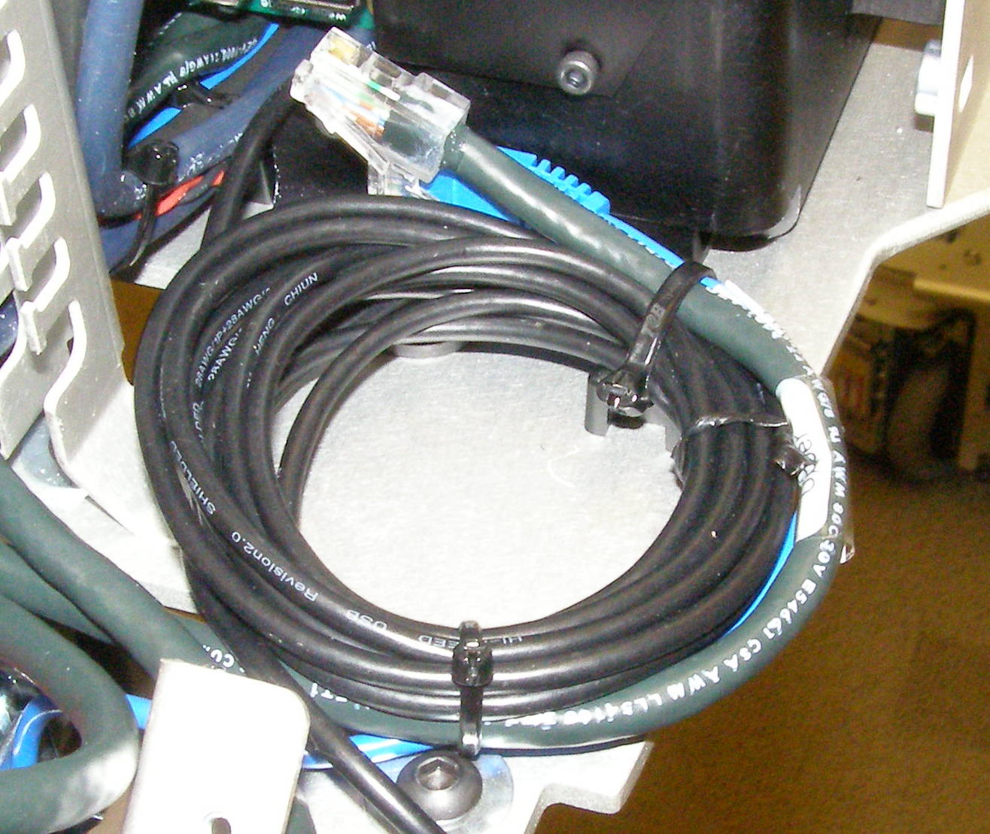
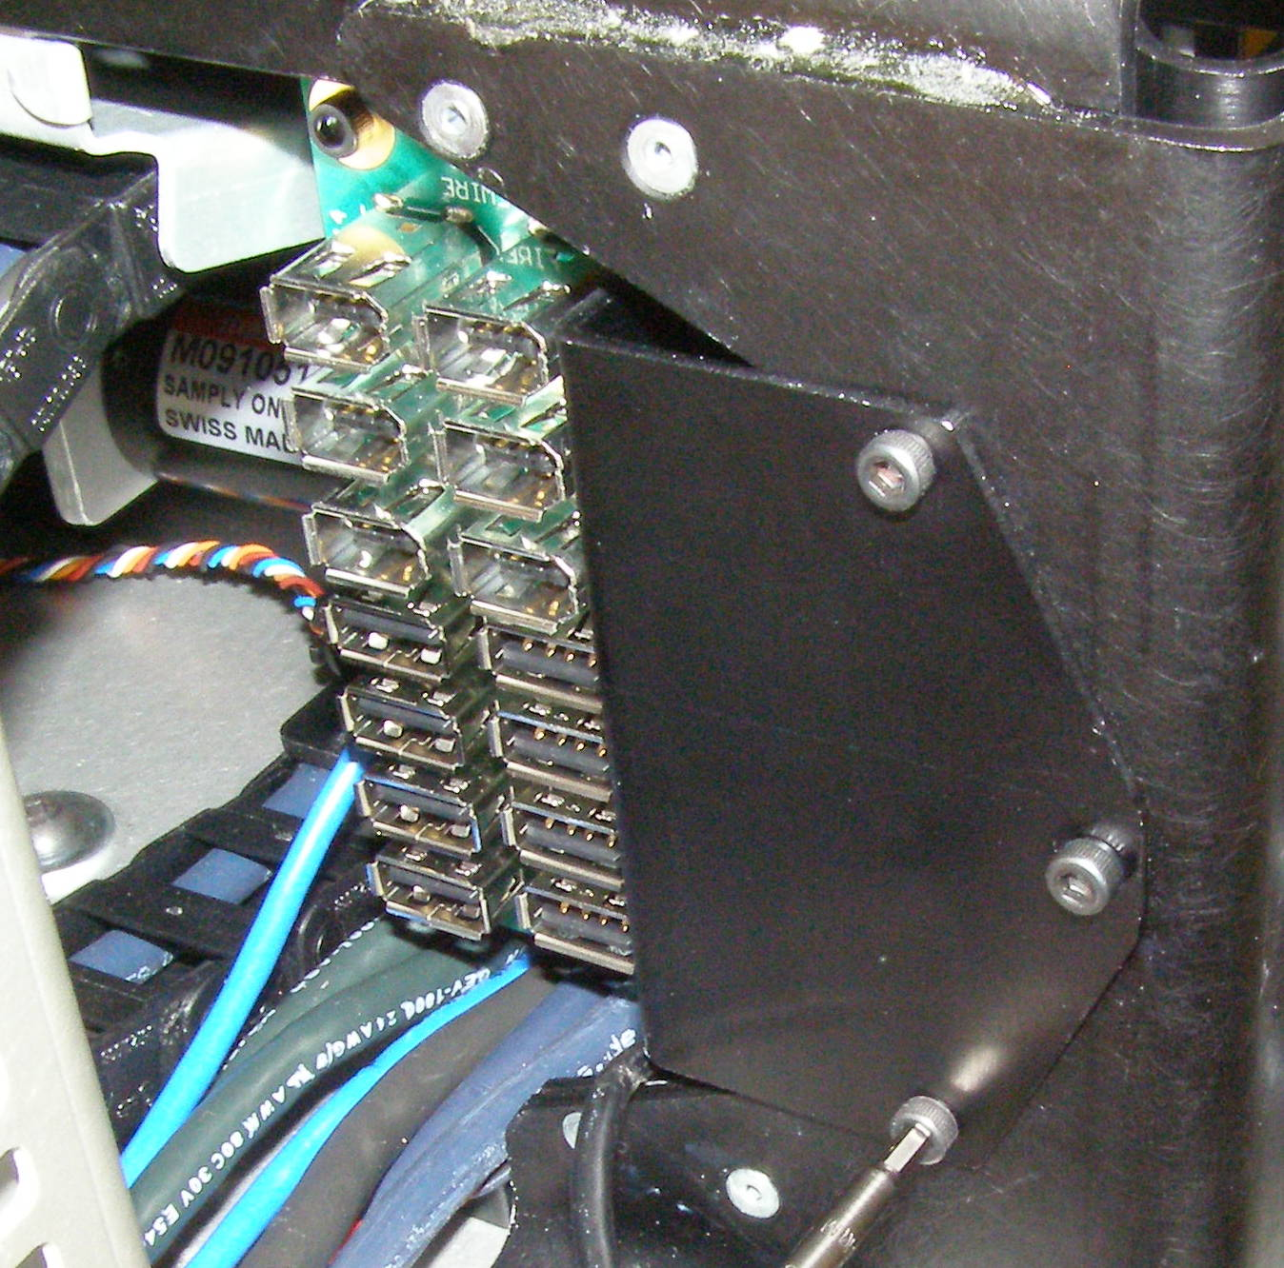
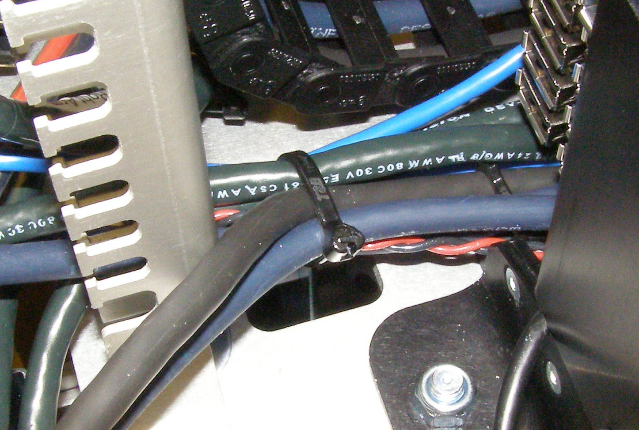
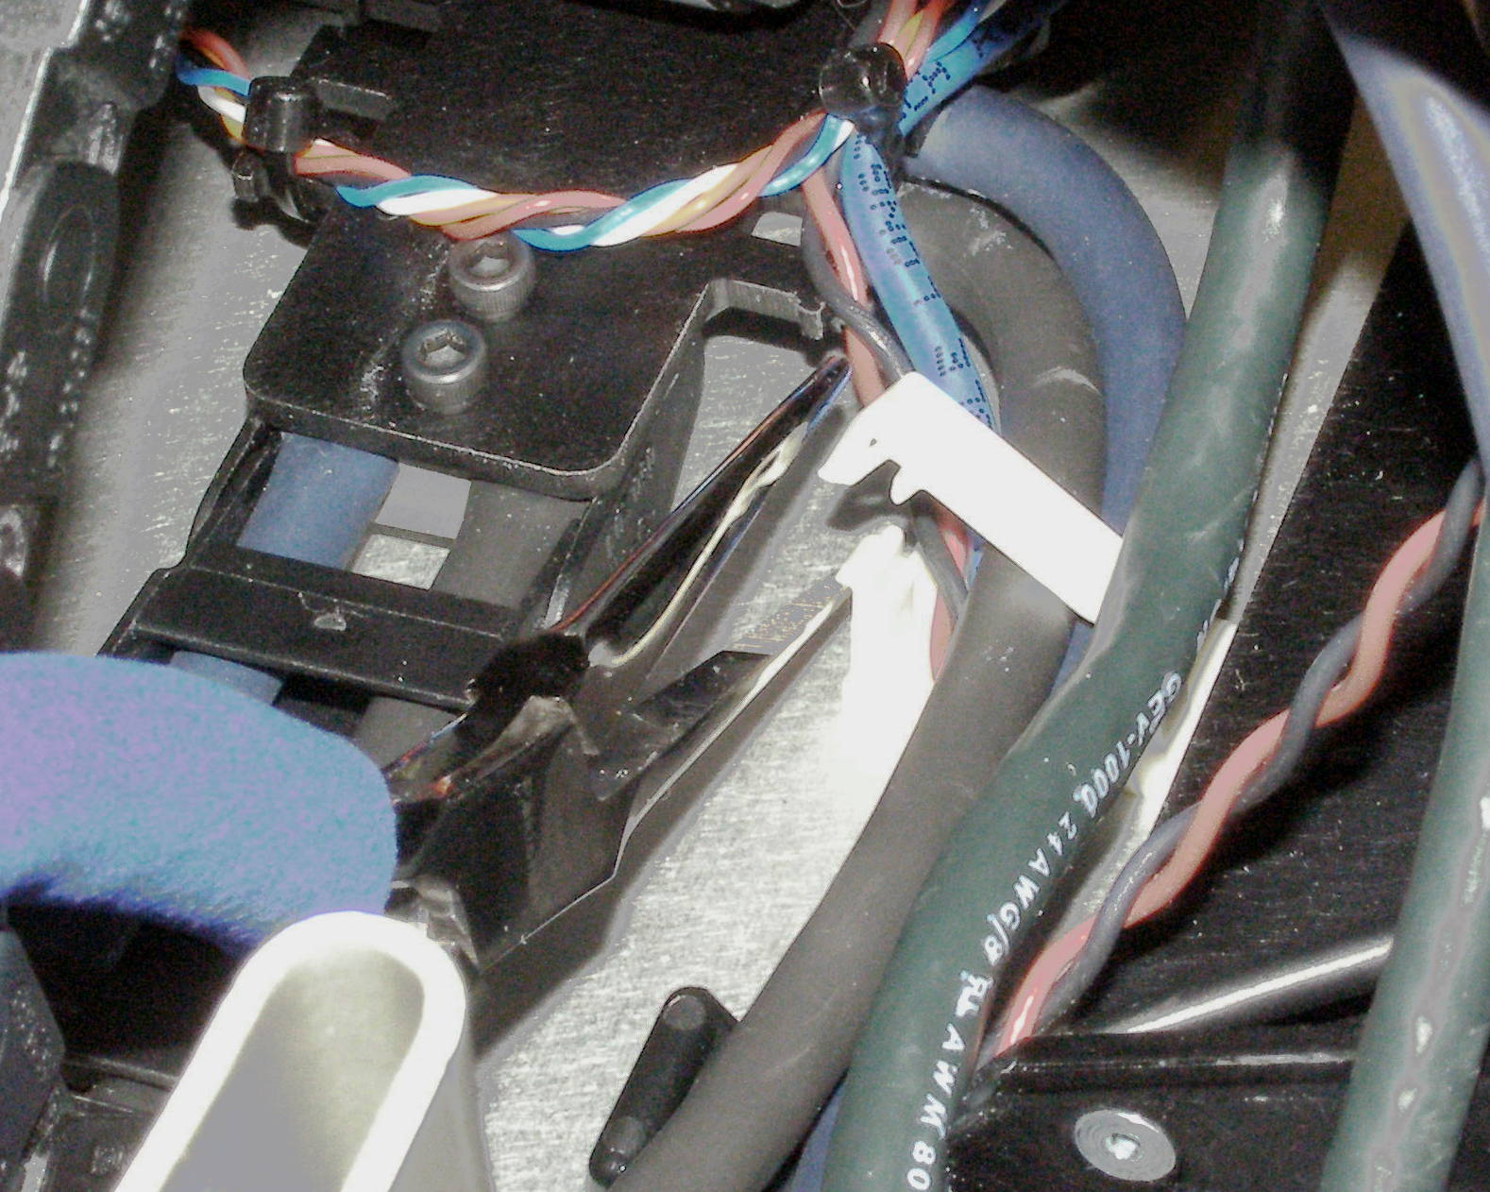
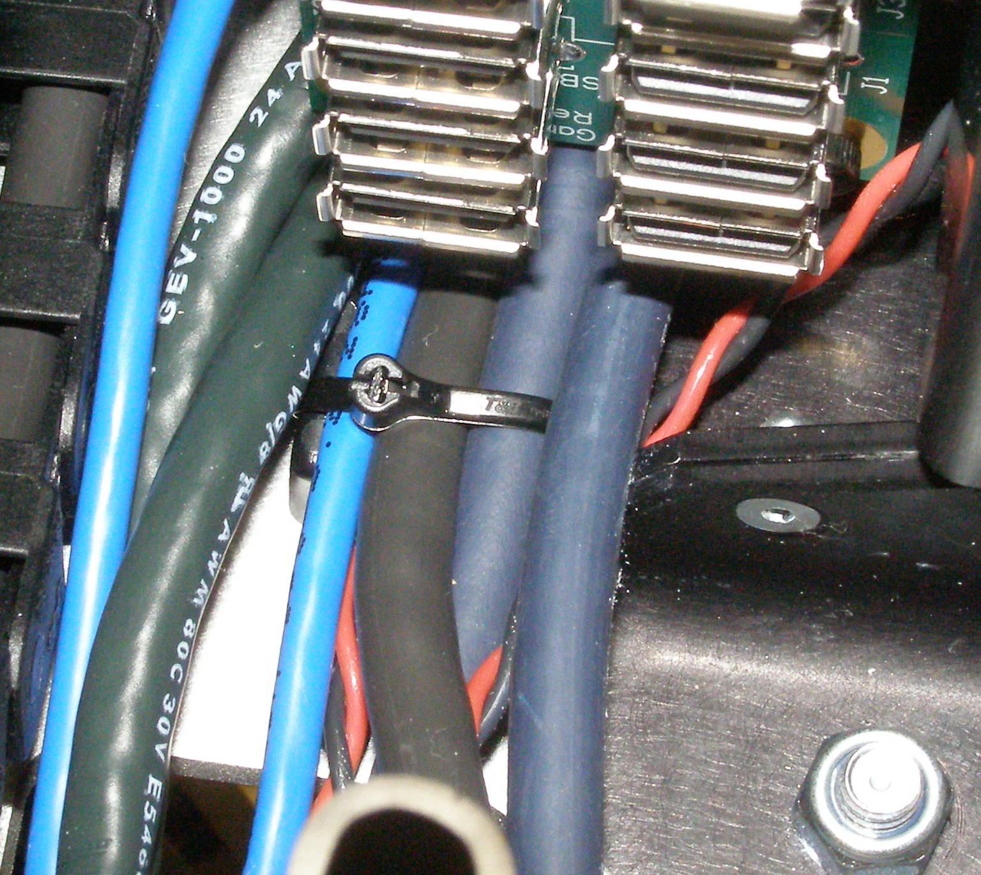
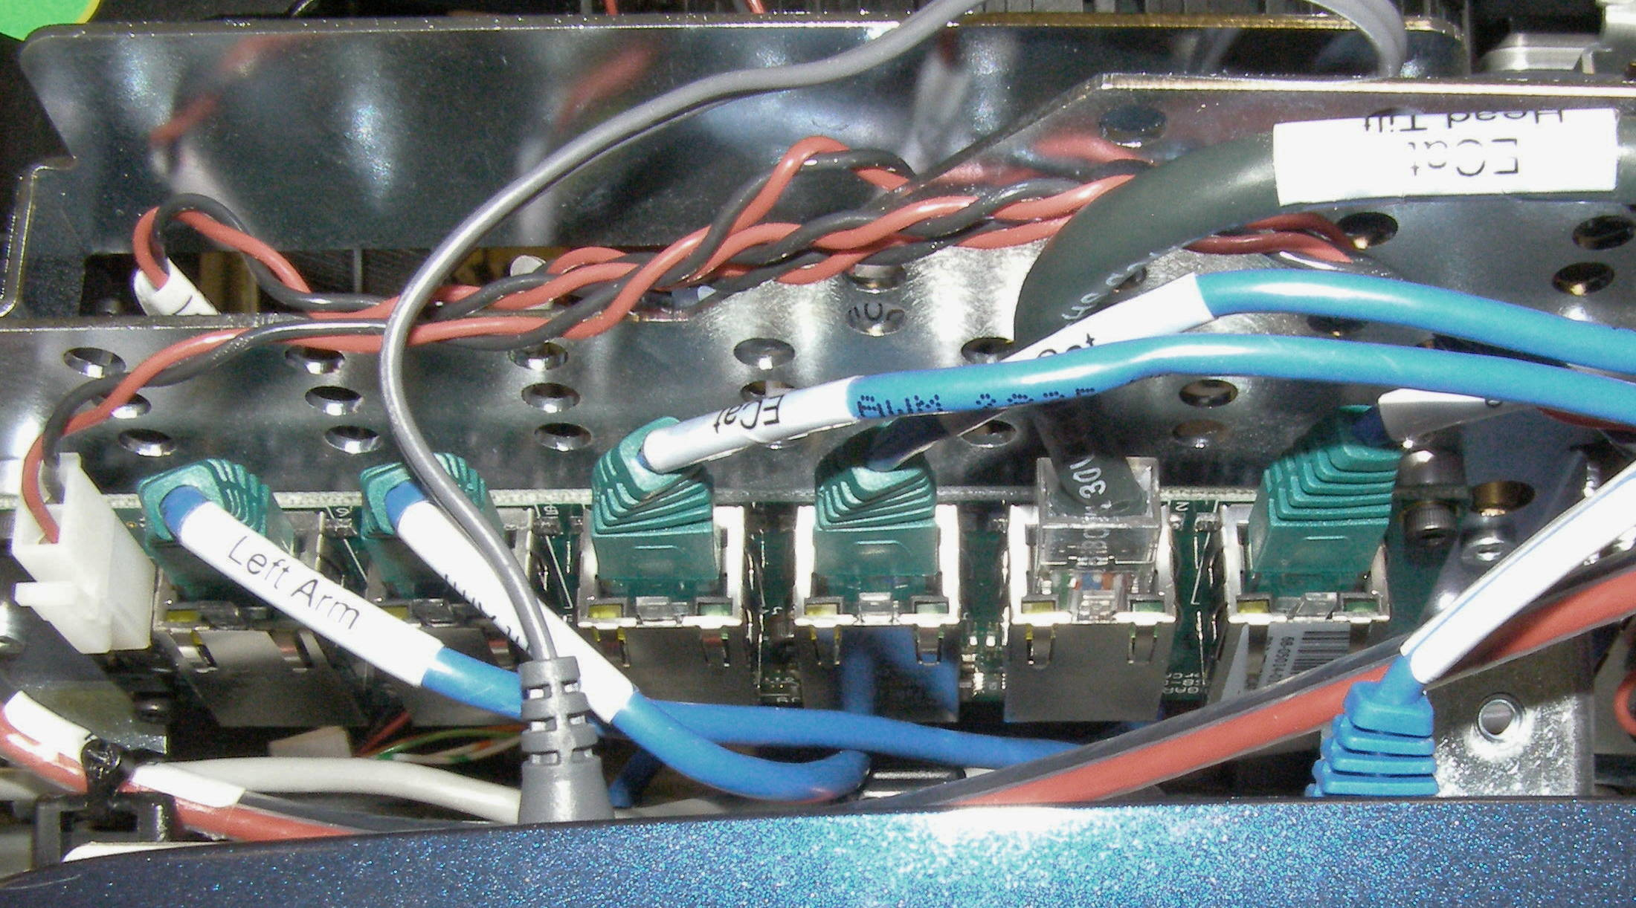
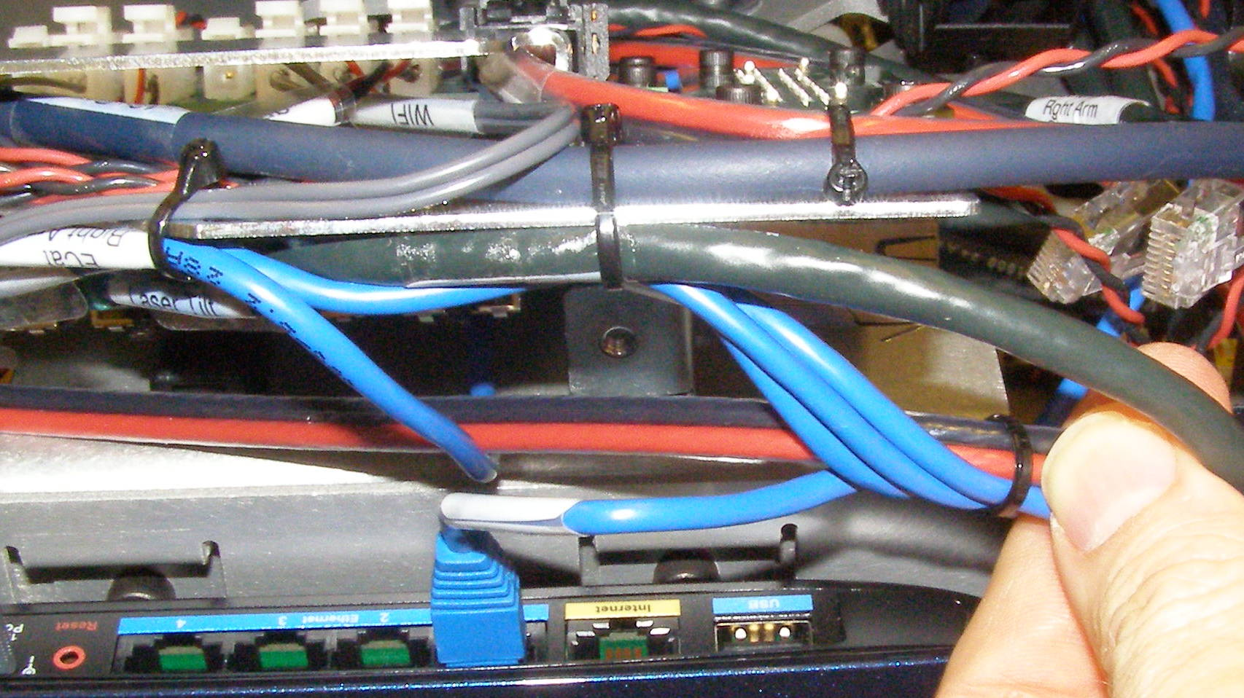
Head Removal (2)
  Cut zip-ties. (Fig 8,9,10,11)
  Using the 2.5mm bit with the T-handle driver, remove the 3 screws retaining the USB Hub Assembly. 2009-06 (Fig 12)
  Using the Needle Nose pliers, unsnap the White cable clamp next to the Laser Sled echain. (Fig 13)
  Unplug “Ecat Head Tilt” and Ecat Head Pan” cables. (Fig 14)
Fig 12
Fig 8
Fig 13
Fig 9
Fig 10
Fig 14
Fig 11

Slide 4
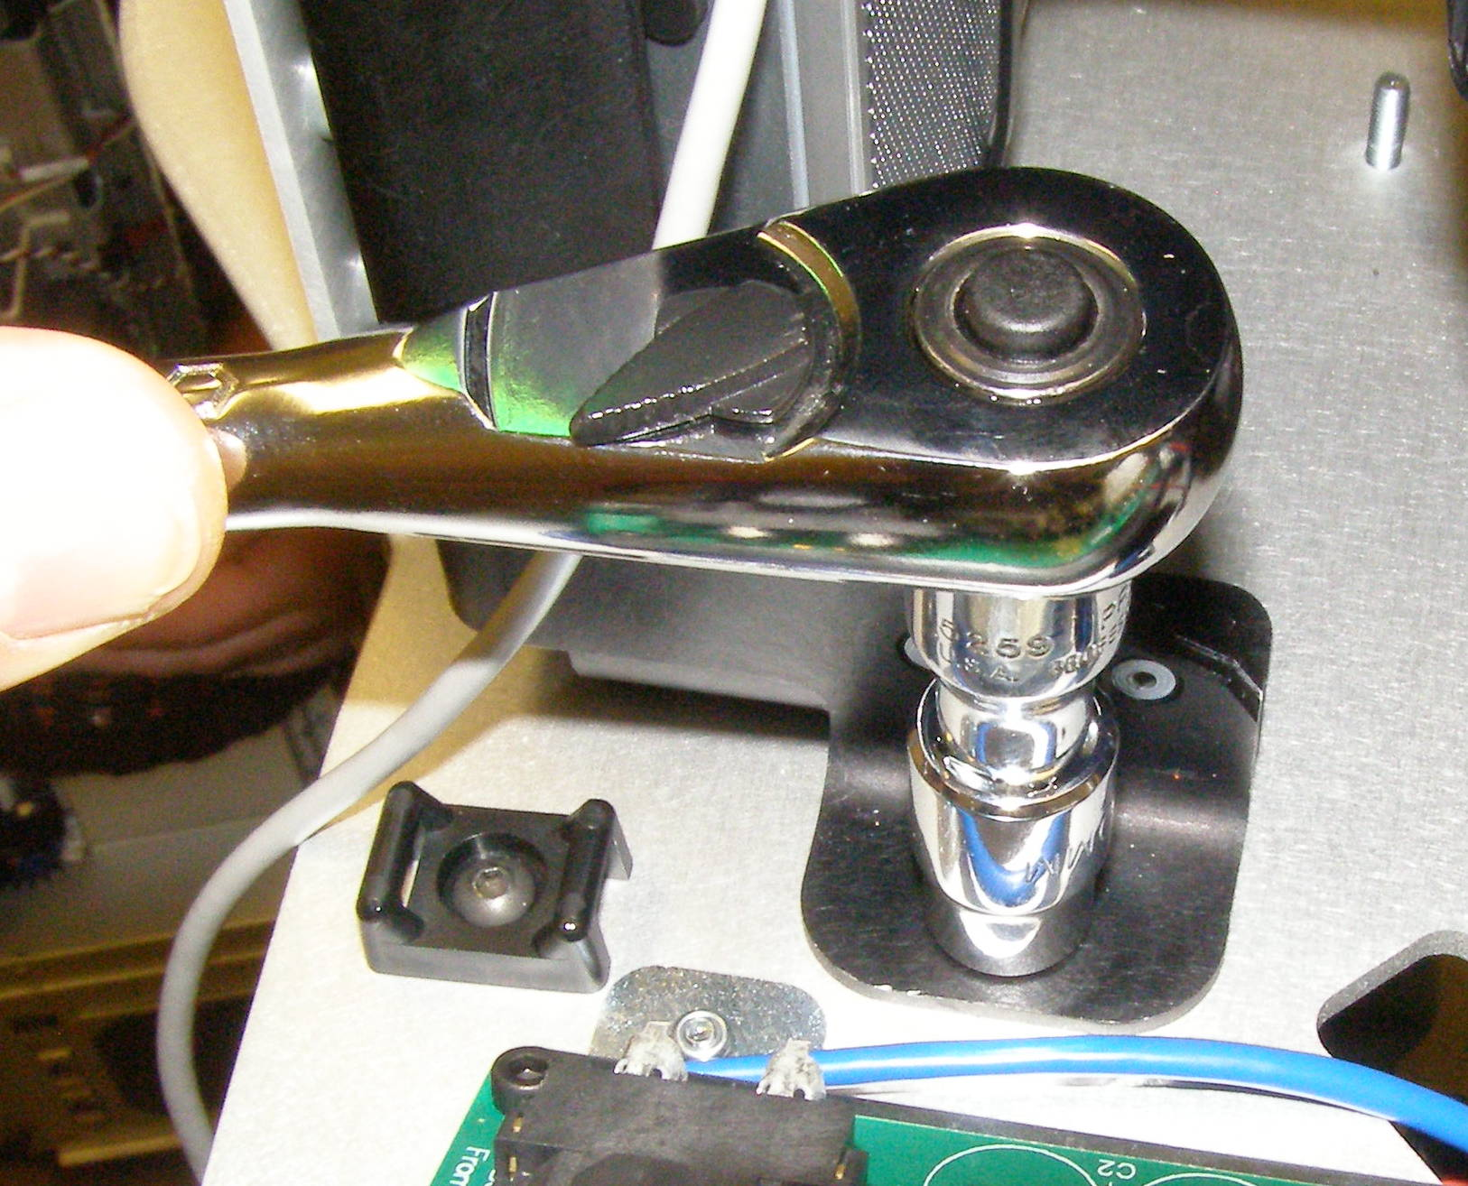
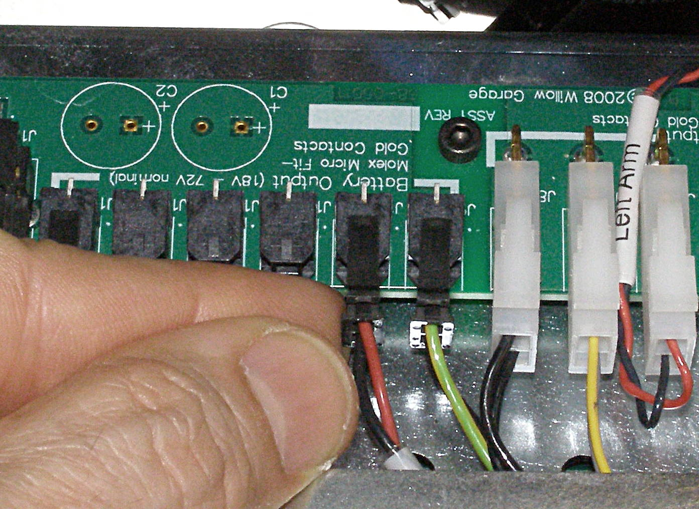
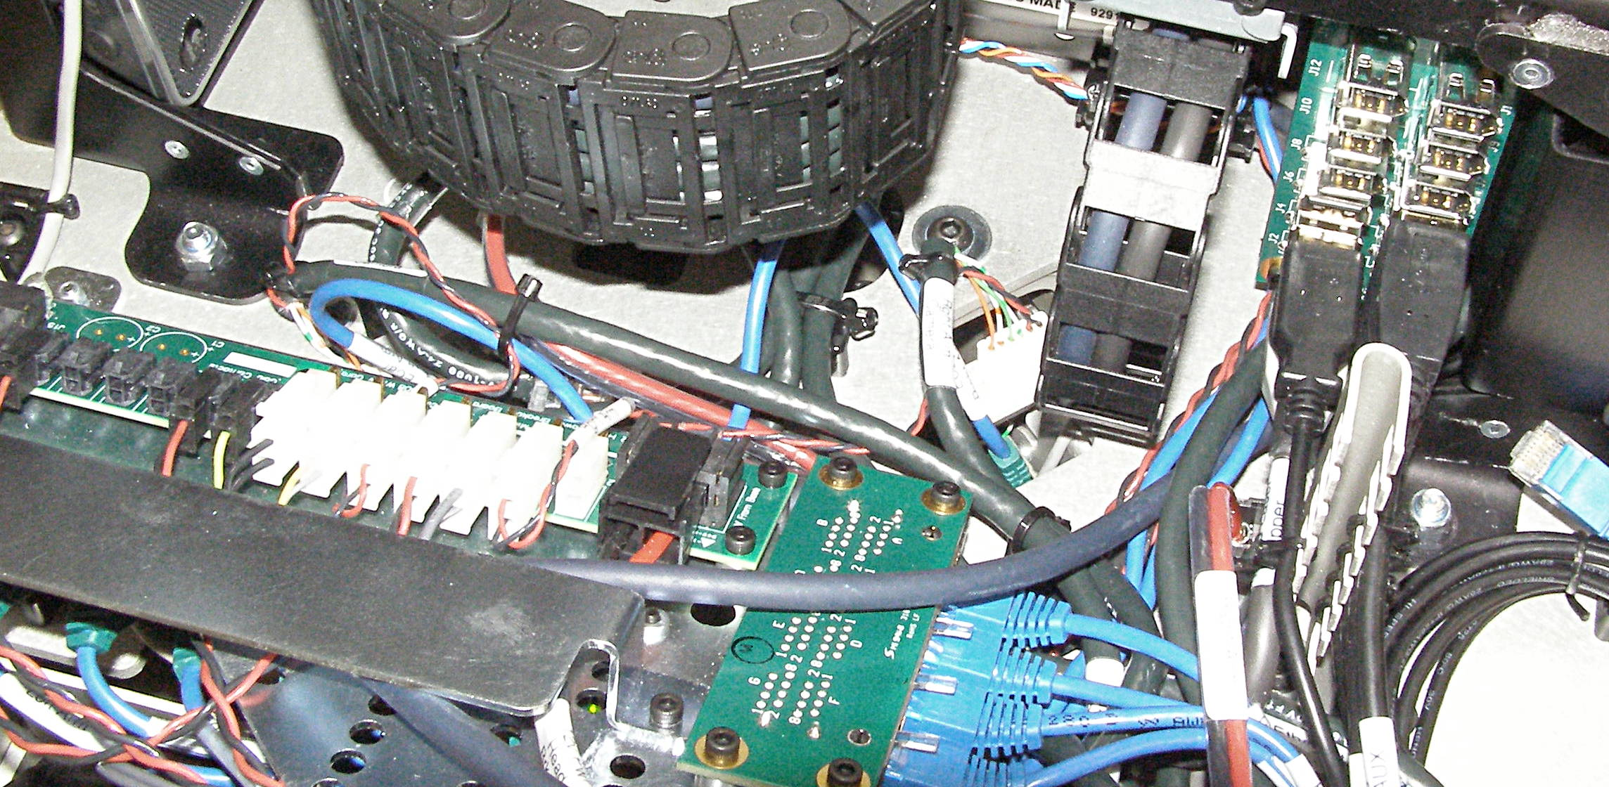
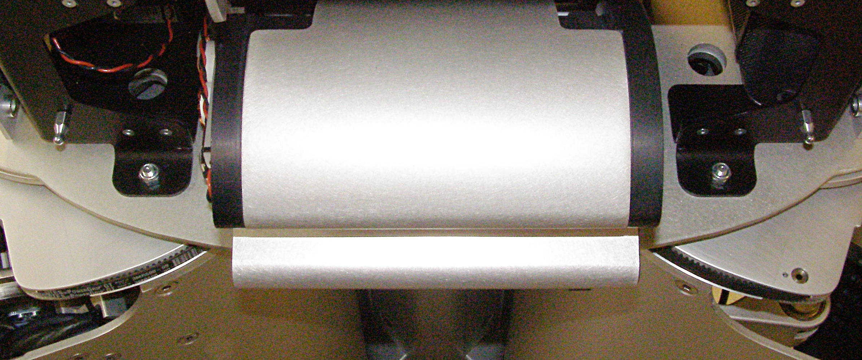
Head Removal (3)
  Unplug “72v Pwr Head Pan” cable (Fig 15)
  Using the 10mm 3/8 drive socket, and the 3/8 extension, and the 3/8 drive ratchet wrench, remove 4 nuts. 1134 (Fig 16,17,18)
Fig 15
Fig 18
Fig 16
Fig 17

Slide 5
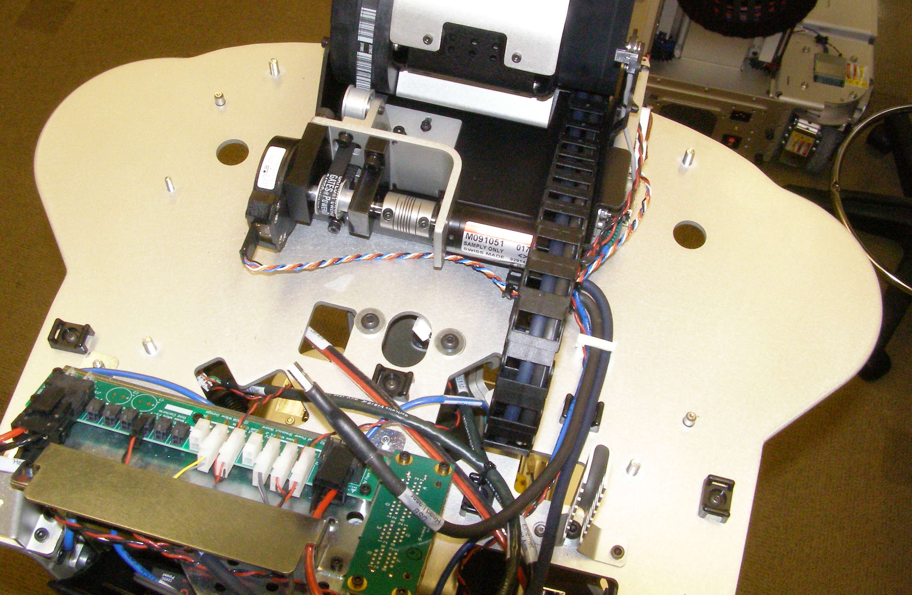
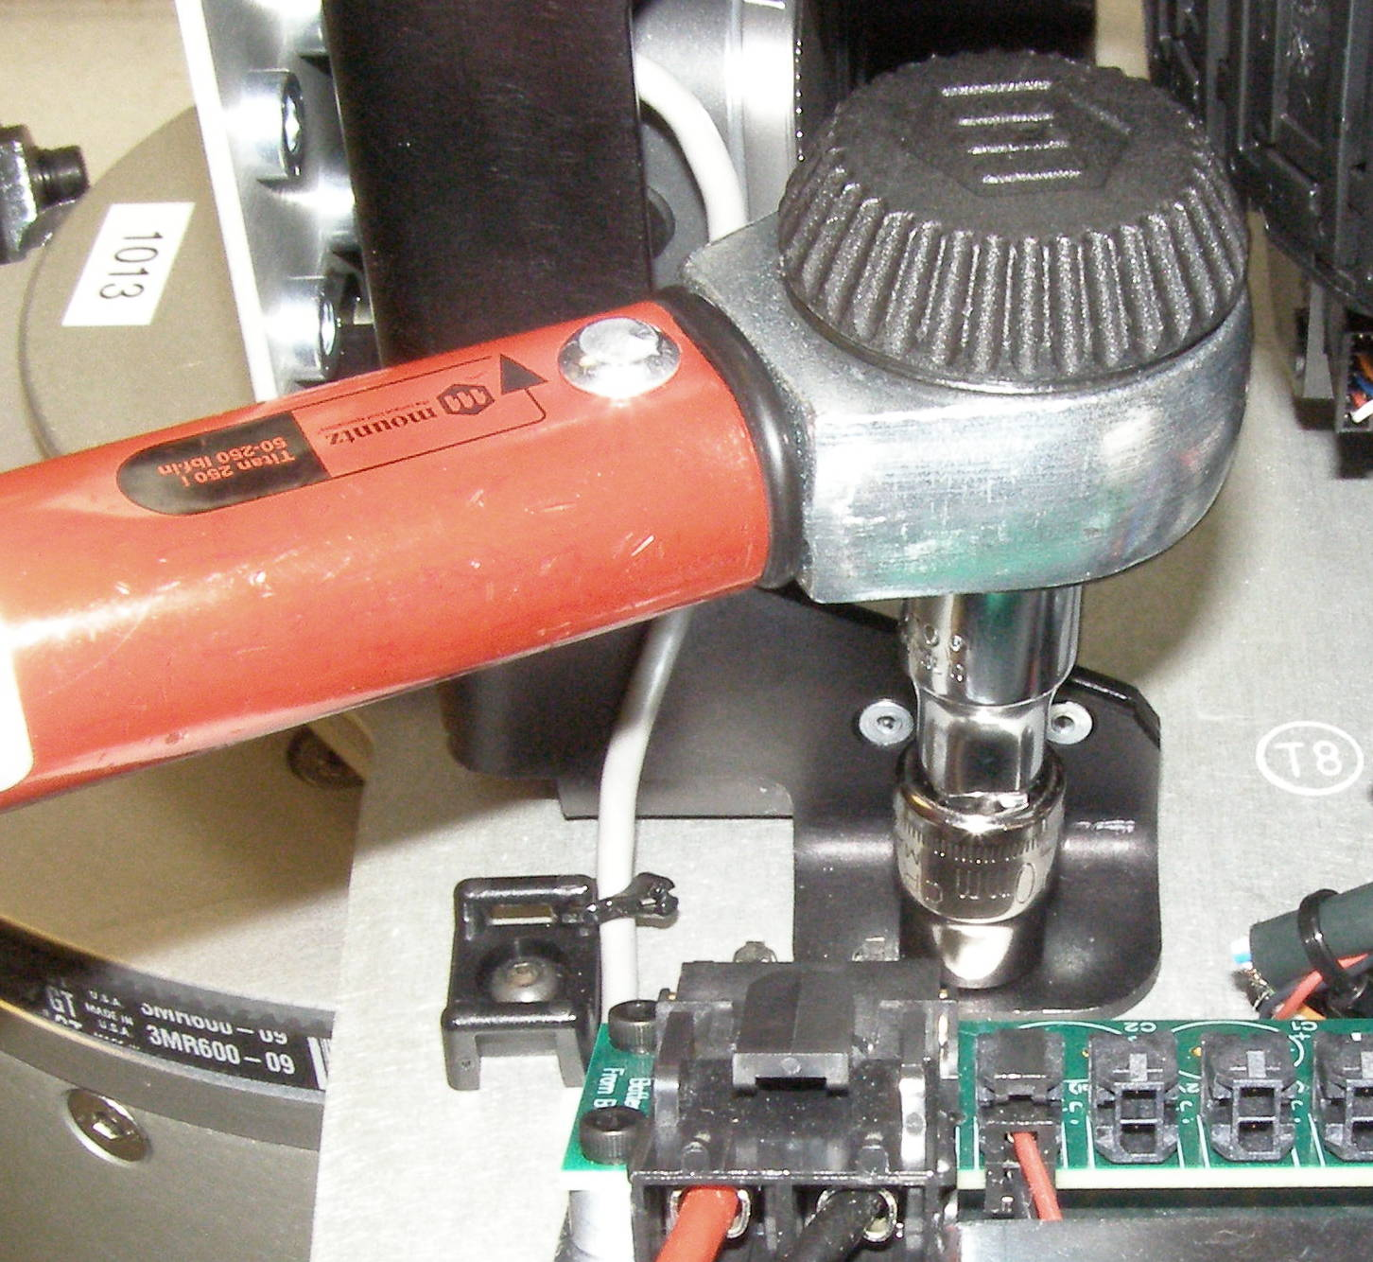
Head Install
Head, Install
  Making sure all of the cables are dressed to the rear, place the Head on the 4 studs. (Fig 1)
  Install the 4 nuts and torque to 11Nm using the Titan Torque wrench together with the 3/8 extension and 10mm socket. (Fig 2)
  Reverse the removal procedure adding zip-ties as needed to replace the cut ones.
  Using Loctite 248, install the 3 USB Hub Assembly mounting screws and torque to 1.36Nm using the Large torque driver. (Fig 3)
  The connector order for the Ethernet Hub is: Bottom are Dark Green cables
    Bottom, front - Gigibit Cam Lower
    Bottom – Stereo Cam Lower
    Bottom – Right Arm Camera
    Bottom – Left Arm Camera
    Top Are Blue cables
    Top, front – Gigabit Camera Lower
    Top – Stereo Camera Lower
    Top – Right Arm Camera
    Top – Left Arm Camera
  The connector order for the USB Hub is:
    Right, bottom – Speaker
    Right – Head Laser Lower
    Right – IMU Lower
    Right – Head Aux
    Left, bottom – Speaker (Gray)
    Left – Head Laser Upper
    Left – IMU
    Empty
Fig 1
5
8
Fig 2
Right
Top
Fig 3

